Slide 1



LONG-LIVED PARTICLES
AND THE
FUTURE OF PARTICLE PHYSICS
CERN Colloquium, 19 June 2023
Jonathan Feng, University of California, Irvine

Slide 2
INTRODUCTION
Long-Lived Particles (LLPs) are particles that are effectively stable or travel an observable distance before they decay.
LLPs have played an essential role in many of the conceptual breakthroughs that established the standard model: e, p, n, μ, K, ν, B, …
LLPs are also likely to play an essential role in the next breakthrough that takes us beyond the standard model of particle physics.
Alimena et al. (eds. Beacham, Shuve) (2019)

Slide 3
INTRODUCTION
LLPs are also likely to play an essential role in the next breakthrough that takes us beyond the standard model. Why?
LLPs are ubiquitous in BSM theories, especially those with cosmological significance.
LLPs can be detected through a huge variety of signatures.
Many of these signals are truly spectacular – a few events can be a discovery.
For existing experiments, we have not yet reached the full LLP discovery potential.
LLPs present many opportunities for new experiments, some of which are already bearing fruit.
LLPs have become a topic of great interest. Here I’ll give a highly personal summary of my reasons for optimism; for more, see the LLP13 Workshop, taking place at CERN now through Friday.

Slide 4
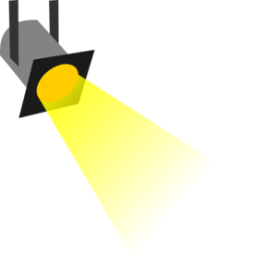
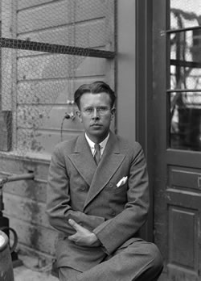
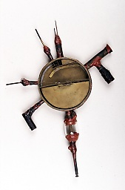
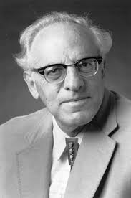







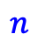

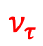











THE PARTICLE LANDSCAPE
Particle
Expts
Mass
MeV
GeV
TeV
1
$$←$$
$$g$$
$$u$$
$$d$$
$$s$$
$$p$$
$$n$$
$$c$$
$$b$$
$$t$$
$$←$$
$$γ$$
$$e$$
$$μ$$
$$τ$$
$$W$$
$$Z$$
$$h$$
Already
Discovered
Strongly Interacting
Heavy Particles
Interaction Strength
10⁻³
$$ν_{e}$$
$$ν_{μ}$$
$$ν_{τ}$$
$$←$$
Weakly Interacting
Light Particles
Impossible to
Discover
10⁻⁶

Slide 5
THE COSMOLOGICAL LANDSCAPE
Particle
Expts
Mass
MeV
GeV
TeV
1
Already
Discovered
Strongly Interacting
Heavy Particles
Too Little to be
Dark Matter
Interaction Strength
Just Right to
be Dark Matter
10⁻³
Weakly Interacting
Light Particles
Impossible to
Discover
10⁻⁶
Too Much to be
Dark Matter

Slide 6
LESSONS FROM OUR PAST
We are not now in a golden age of particle physics.
But particle physics is still fascinating, and the possibilities for deep connections to cosmology have never been stronger.
The discovery of new particles is the gold standard for progress in particle physics. (Precision measurements are also very important.)
Buoyed by past successes, we have been looking for strongly-interacting heavy particles that decay quickly, and this should continue.
But typically, unless these are in a narrow window of masses (e.g., ~2-4 TeV for gluinos), we will not find them in the next two decades. And the most robust problems, neutrino masses and dark matter, naturally point toward very weakly-interacting particles.
To bring us to a new golden age, we need to try new things and diversify our searches for BSM physics without breaking the bank. (As we will see, LLPs are currently a very good investment!)

Slide 7
THE LLP LANDSCAPE
Particle
Expts
Mass
MeV
GeV
TeV
1
Already
Discovered
LLPs from Weak-Scale Physics
Interaction Strength
10⁻³
LLPs from Light Physics
Impossible to
Discover
10⁻⁶

Slide 8
LLPS FROM
WEAK- SCALE PHYSICS

Slide 9
WEAK-SCALE PHYSICS AND LLPS
Why should there be LLPs at the weak scale? After all, the natural decay length is cτ ~ c/m_{W} ~ 10⁻¹⁷ m!
But the gauge hierarchy problem → new physics at 100 GeV, and
precision EW (LEP) → no new physics below few TeV in 4-pt interactions
Simple solution: impose a discrete parity, so all interactions require pairs of new particles.
Gauge Hierarchy
Precision EW
new
particle
SM
SM
Higgs
Higgs
new
particle
SM
SM
This makes the lightest new particle stable: an LLP. This is a general argument. It may be augmented in specific contexts, e.g., in SUSY, p decay → R-parity → stable LSP.
Cheng, Low (2003); Wudka (2003); Farrar, Fayet (1974)

Slide 10
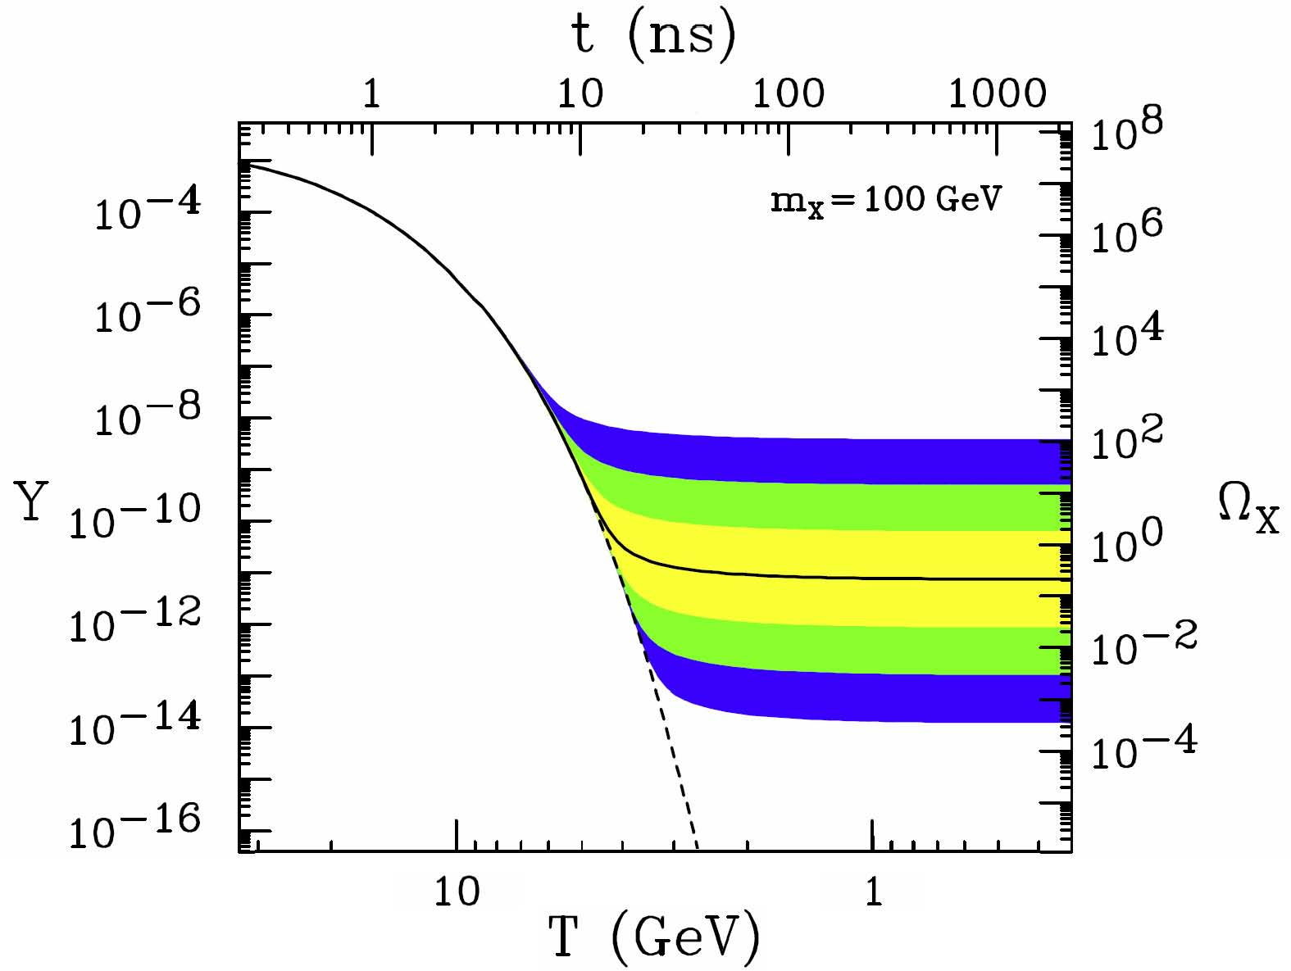
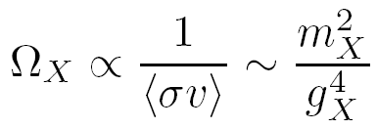
WEAK-SCALE PHYSICS AND COSMOLOGY
What good is a stable weak-scale state? Dark matter!
The resulting relic density is
For a WIMP, m_{X} ~ 100 GeV and g_{X} ~ 0.6 → Ω _{X} ∼ 0.1
X
f
X
f̅
This simple coincidence, the WIMP Miracle, ties together weak-scale physics, LLPs, and cosmology, and has led to the prominence of missing E_{T} searches and DM at colliders.

Slide 11
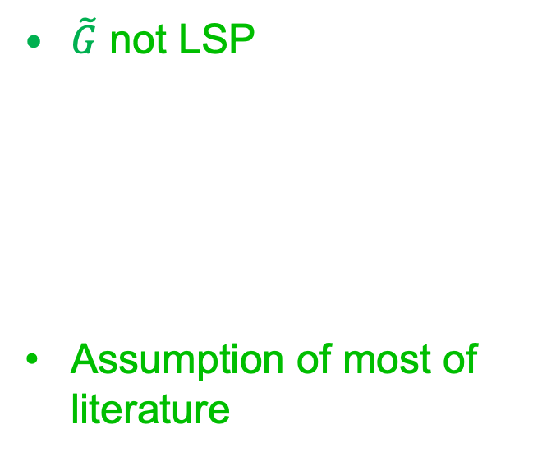
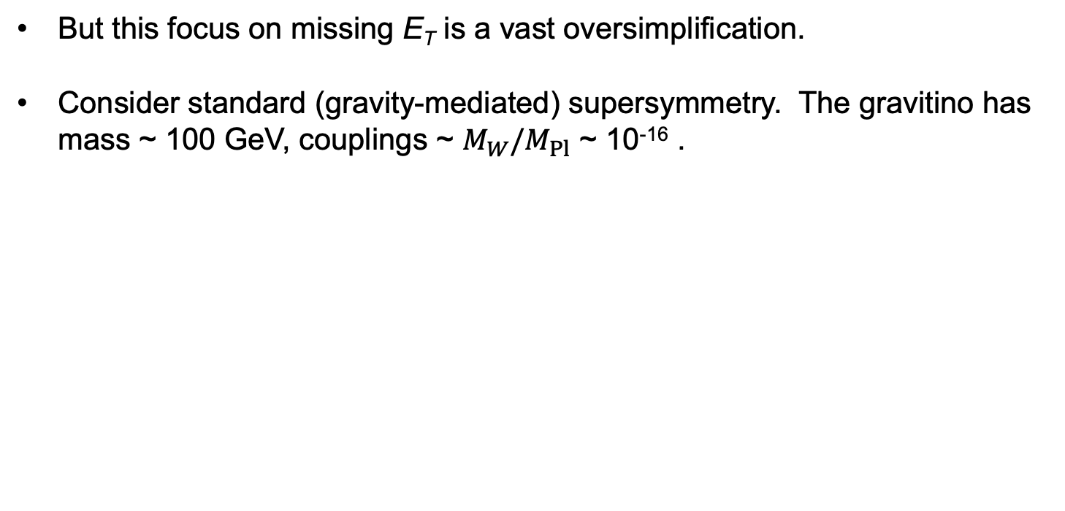
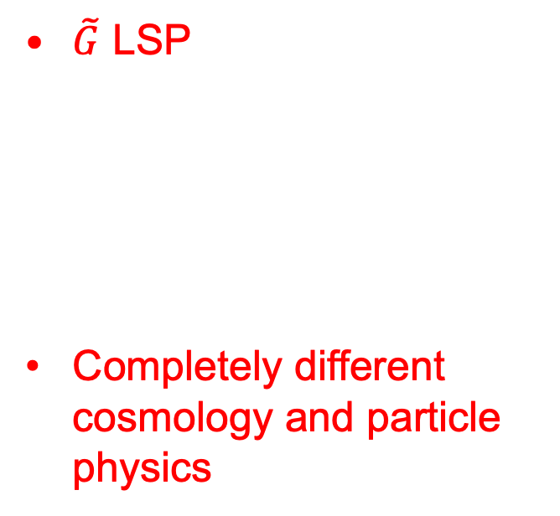
LLPS IN STANDARD SUSY
But this focus on missing E_{T} is a vast oversimplification.
Consider standard (gravity-mediated) supersymmetry. The gravitino has mass ~ 100 GeV, couplings ~ $M_{W}/M_{Pl}$ ~ 10⁻¹⁶ .
$\tilde{G}$ not LSP
Assumption of most of literature
$\tilde{G}$ LSP
Completely different cosmology and particle physics
SM
SM
G̃
NLSP
LSP
G̃

Slide 12
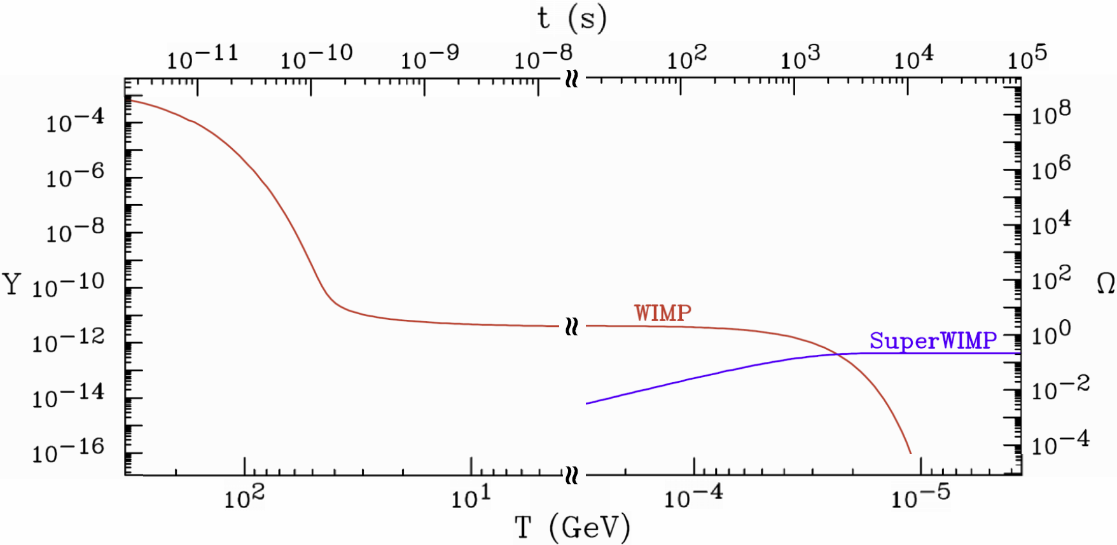
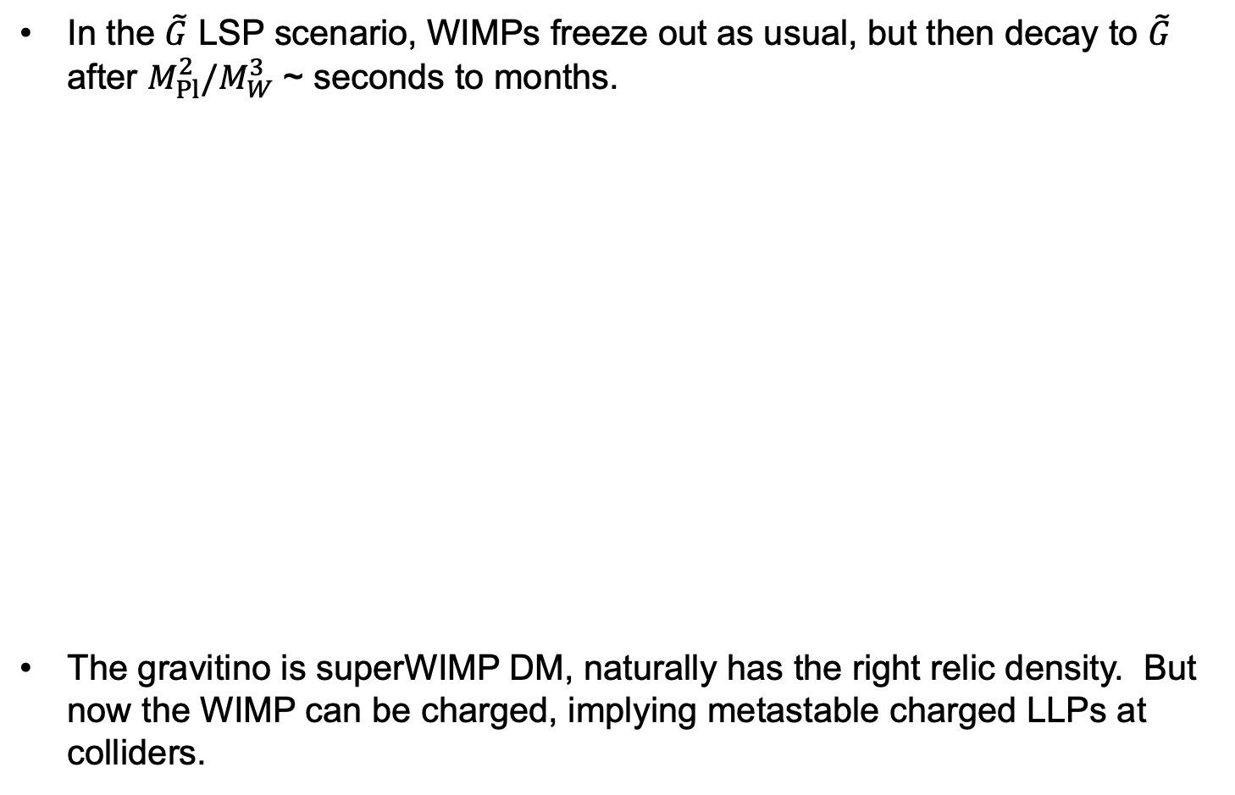
LLPs IN SUPERWIMP SCENARIOS
In the $\tilde{G}$ LSP scenario, WIMPs freeze out as usual, but then decay to $\tilde{G}$ after $M_{Pl}^{2}/M_{W}^{3}$ ~ seconds to months.
The gravitino is superWIMP DM, naturally has the right relic density. But now the WIMP can be charged, implying metastable charged LLPs at colliders.
Feng, Rajaraman, Takayama (2003)

Slide 13
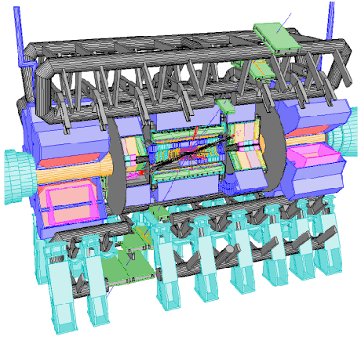
LLPS AND AUXILIARY DETECTORS
If we see metastable charged LLPs, we know they must decay.
We can collect these particles and study their decays.
Several ideas have been proposed
Catch sleptons in a 1m thick water tank (up to 1000/year) and then move them to a quiet place to observe their decays Feng, Smith (2004)
Catch sleptons in LHC detectors
Hamaguchi, Kuno, Nakawa, Nojiri (2004)
Dig sleptons out of detector hall walls
De Roeck, Ellis, Gianotti, Moortgat, Olive, Pape (2005)
Charged particle trap
Reservoir
Notes:
13

Slide 14
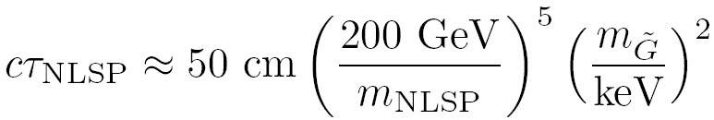
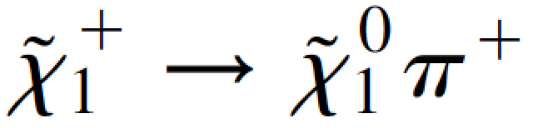
LLPS IN OTHER SUSY MODELS
SuperWIMPs lead to very long lifetimes, but there is a continuum of possibilities in SUSY models (GMSB), with the lifetime controlled by the gravitino mass.
In other SUSY models (AMSB), naturally small degeneracies lead to other remarkable signals, e.g., disappearing tracks from .
Dine, Nelson, Nir, Shirman (1994); Dimopoulos, Dine, Raby, Thomas (1996)
 | Neutralino NLSP | Slepton NLSP
Prompt | Prompt photons | Multi-leptons
Intermediate | Displaced photons Displaced conversion | Displaced lepton Track kinks
Long-Lived | Missing E_{T} | Time-of-flight High dE/dx
Randall, Sundrum (1998); Giudice, Luty, Murayama, Rattazzi (1998); Feng, Moroi, Randall, Strassler, Su (1999)
Notes:
14

Slide 15
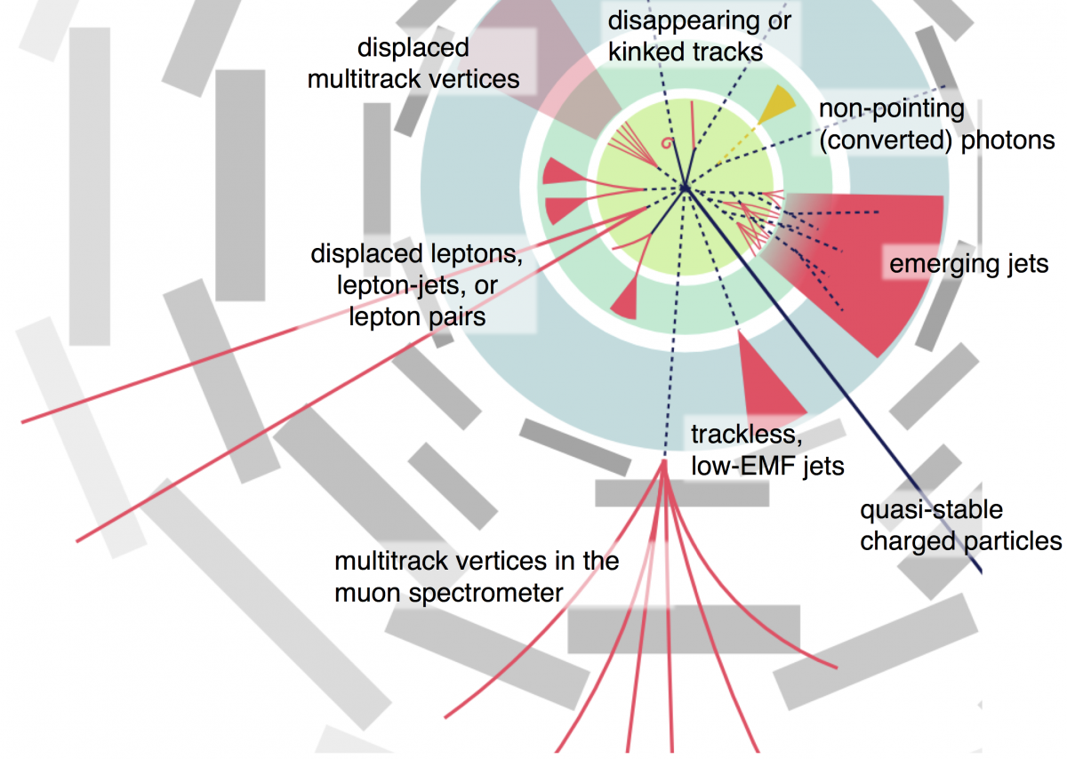
LLP SIGNATURES AT ATLAS AND CMS
These models lead to many possible signatures, which are spectacular, if one is looking for them. Requires excellent knowledge of detectors, dedicated triggers, special reconstruction methods, …
Russell (see, e.g., LLP White Paper 2019)
Notes:
15

Slide 16
LLPs IN OTHER WEAK-SCALE MODELS
By considering a few standard models of weak-scale physics, we have motivated a plethora of possible LLP signatures.
Of course, there are many other motivated weak-scale models with LLPs.
In SUSY: e.g., R-parity violating SUSY and compressed SUSY, which have become more motivated as generic, sub-TeV SUSY becomes excluded.
Extra dimensional scenarios typically have similar possibilities (e.g., viewing universal extra dimensions as bosonic supersymmetry), and naturally compressed spectra.
Many other motivations and cosmological connections: leptogenesis, neutrino masses, etc.
Notes:
16

Slide 17
LLPS FROM
LIGHT PHYSICS

Slide 18
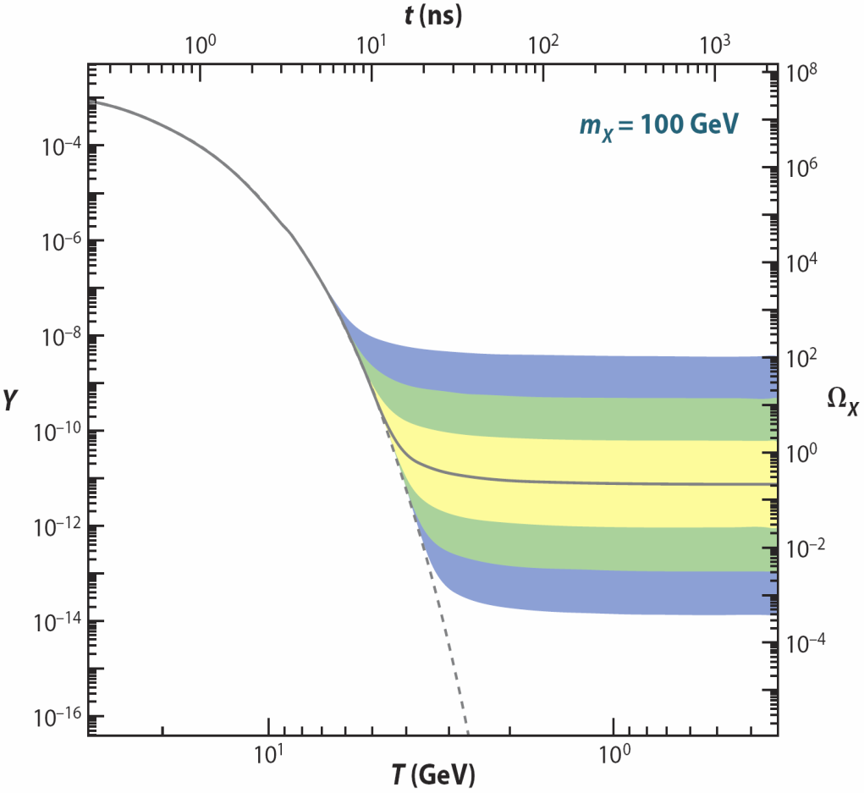
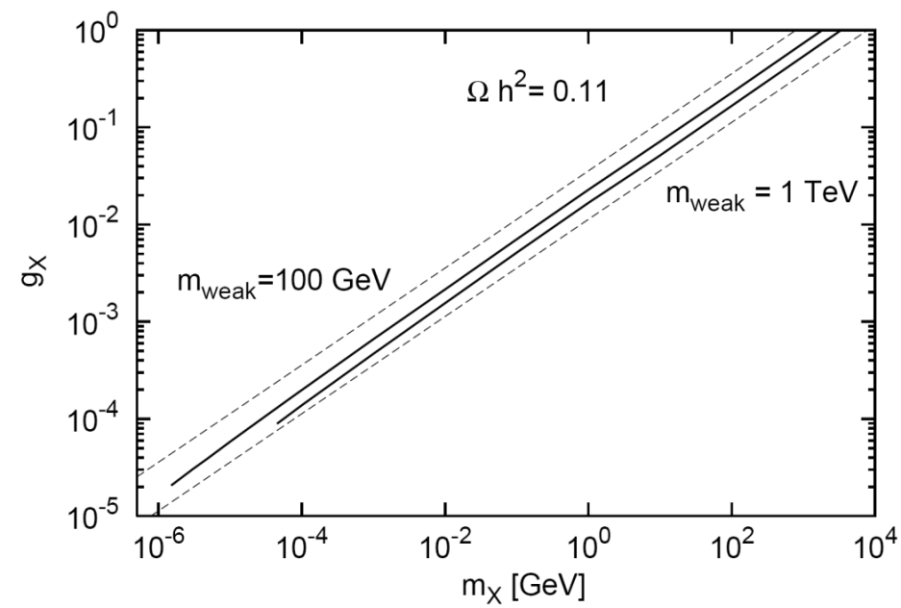
DARK SECTORS
Dark matter may be part of a dark sector, with its own set of forces. What do we know about its properties?
In general, nothing. But suppose DM is produced in the dark sector just as we discussed above for WIMPs in the visible sector:
WIMP Miracle: g_{X} ~ 1, m_{X} ~ 100 GeV → right abundance.
WIMPless Miracle: But with a dark sector, we don’t need to fix g_{X} ~ 1. The dark sector can have lighter particles and weaker interactions and still have the right abundance.
_{WIMP DM}
Feng, Tu, Yu (2010)
_{WIMPless DM}
Boehm, Fayet (2003); Pospelov, Ritz, Voloshin (2007)
Feng, Kumar (2008)

Slide 19

PORTALS
Dark sectors need not talk with us. But if they do, what are the most likely non-gravitational interactions?
Suppose the dark sector has U(1) electromagnetism. There are infinitely many possible SM-dark sector interactions, but one is induced by arbitrarily heavy mediators:
It is “most likely” because it is non-decoupling. Cf.
It is also naturally small, since it is induced by a loop.
SM
Dark
U(1)
M
Holdom (1986)

Slide 20
DARK PHOTON, DARK HIGGS, HNLS
This provides an organizing principle that motivates specific examples of new, weakly interacting light particles. There are just a few options:
Spin 1
→ dark photon, couples to SM fermions with suppressed couplings proportional to charge: εq_{f}. _{Holdom (1986)}
Spin 0
→ dark Higgs boson, couples to SM fermions with suppressed coupling proportional to mass: sin θ m_{f}. _{Patt, Wilczek (2006)}
Spin 1/2
→ Heavy neutral leptons, mixes with SM νs with suppressed mixing sin θ.
SM
Dark
Force
SM
Dark
Scalar
SM
Dark
Fermion

Slide 21
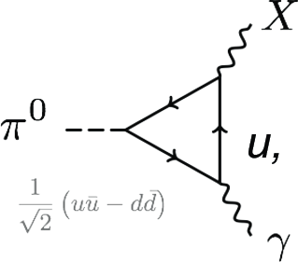
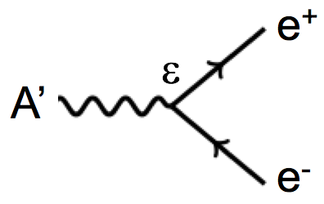
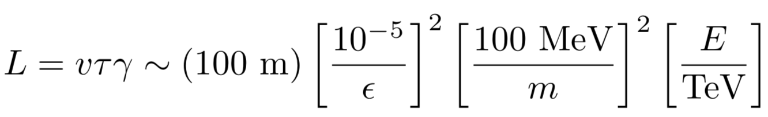
LIGHT LLP PHENOMENOLOGY
Dark sectors, along with axion-like particles, light gauge bosons, etc., have highlighted a new class of LLPs: light, neutral particles, with extremely weak interactions and fascinating phenomenology.
Because they are light, they may be produced in the decay of both heavy and light SM particles (and also in other ways).
Because they are very weakly-interacting, they pass through matter without interacting, but then may visibly decay after a long distance.
LLP
ε
LLP
ε
h
LLP

Slide 22
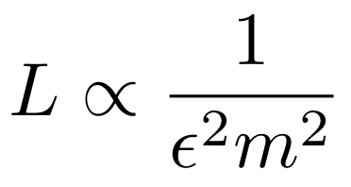
THE LIFETIME FRONTIER
Particle
Colliders
Mass
MeV
GeV
TeV
1
Already
Discovered
Strongly Interacting
Heavy Particles
MUCH LONGER
LIFETIMES
Interaction Strength
10⁻³
Weakly Interacting
Light Particles
Impossible to
Discover
10⁻⁶

Slide 23
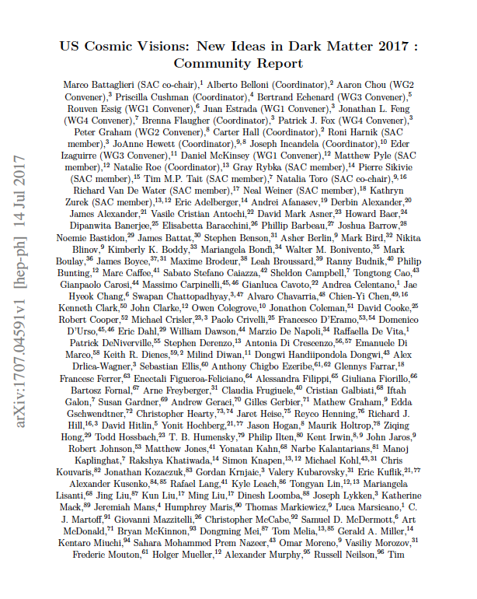
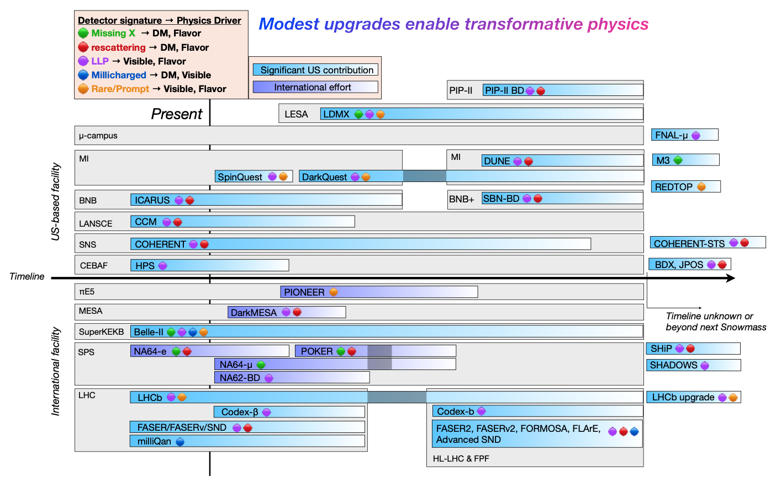
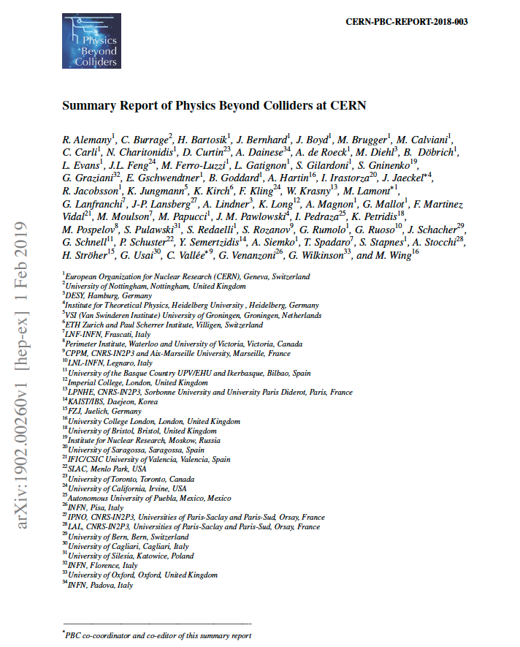
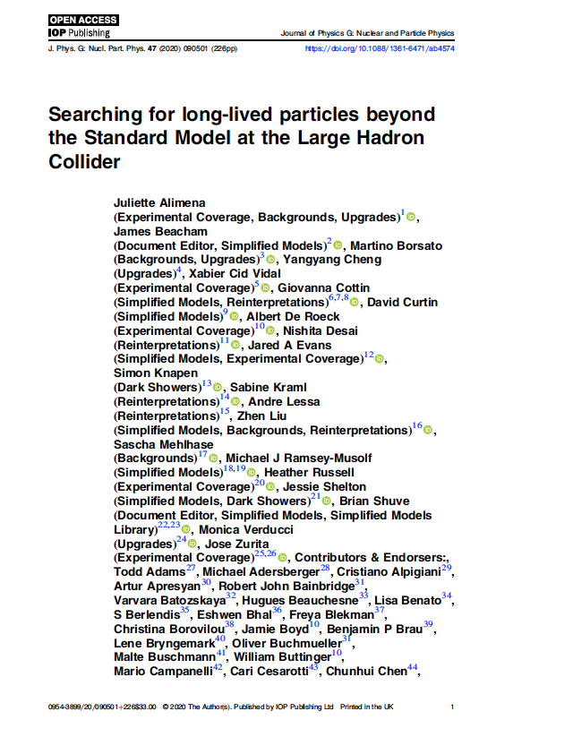
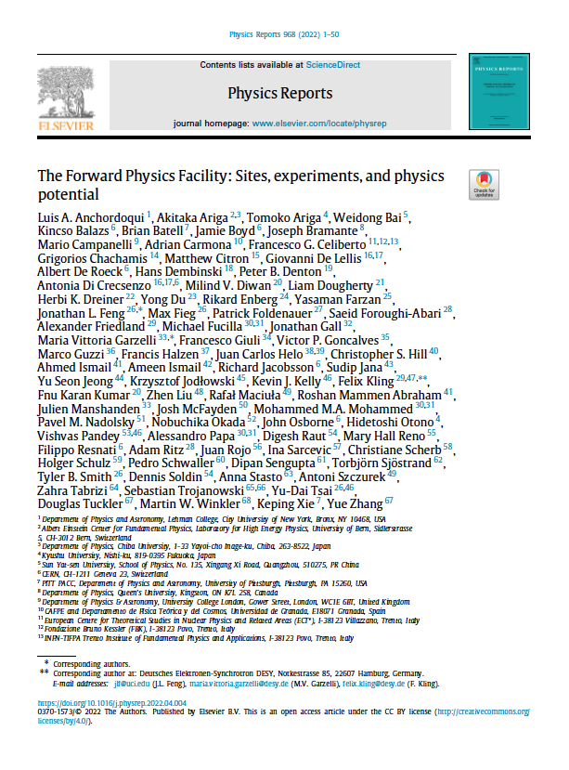
SEARCHES FOR LIGHT LLPS
BSM physics has been re-invigorated by new ideas for LLP searches.
Many large community studies (LLP Community, PBC at CERN, Snowmass in the US, …), and many new experiments have been proposed for labs around the world.
Ilten, Tran et al. (2206.04220)

Slide 24
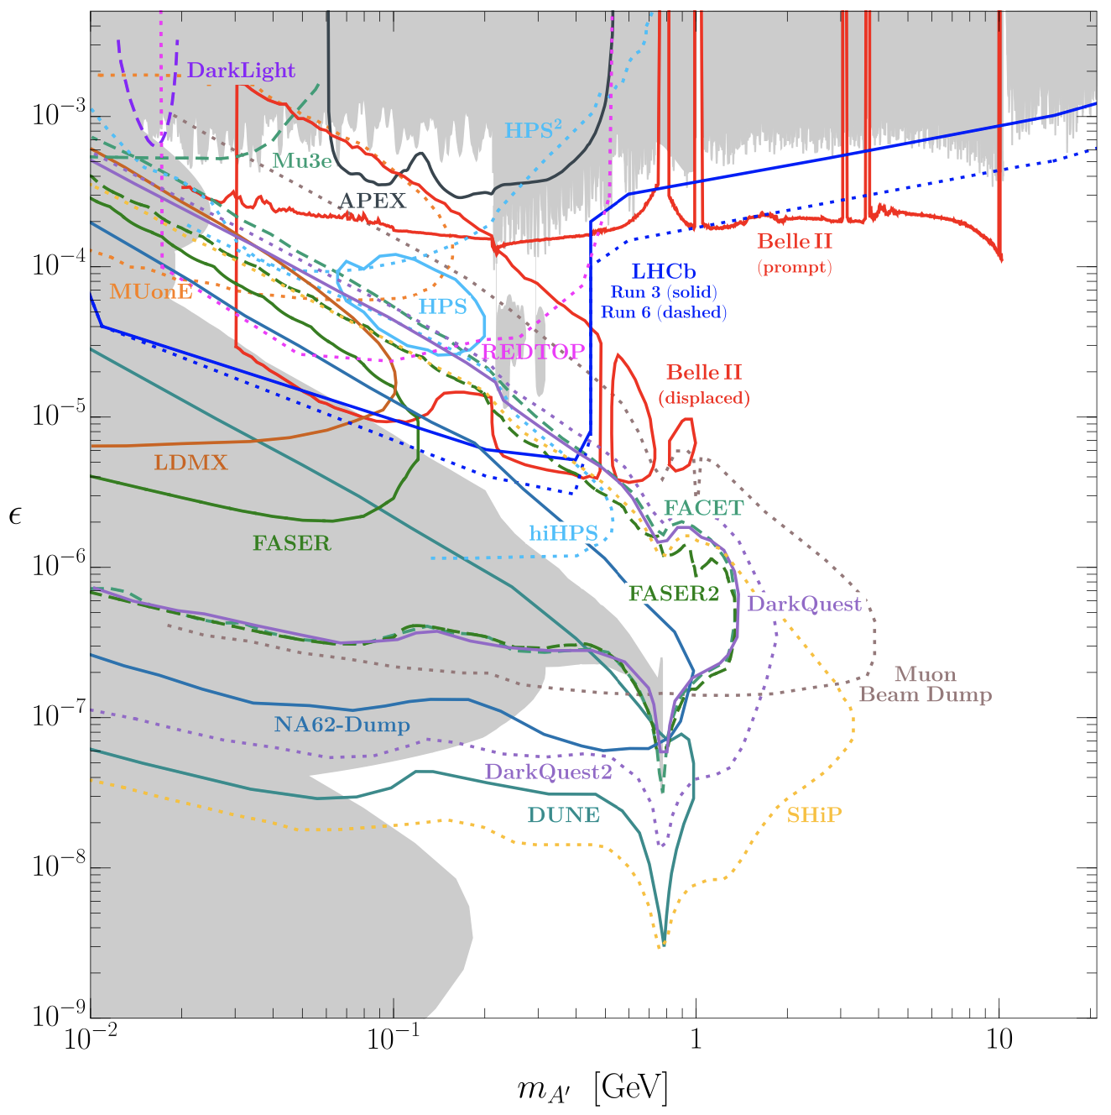
CURRENT EXPERIMENTAL SEARCHES
The sensitivities of ongoing and proposed experiments have been evaluated by these large community efforts.
For example, for dark photons, in the next few years, the thermal relic region will be probed by currently running experiments (LHCb, Belle2, NA62, NA64, FASER, …) and also potentially by proposed experiments.
This is the low-hanging fruit of dark sectors – similar to Z-mediated WIMP cross sections for DM direct detection. In a few years, this parameter space will look completely different.
Batell et al. (2207.06905)

Slide 25
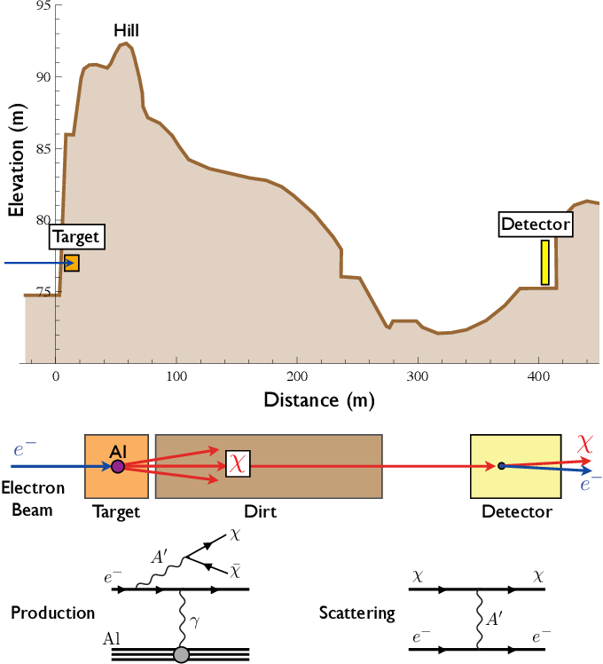
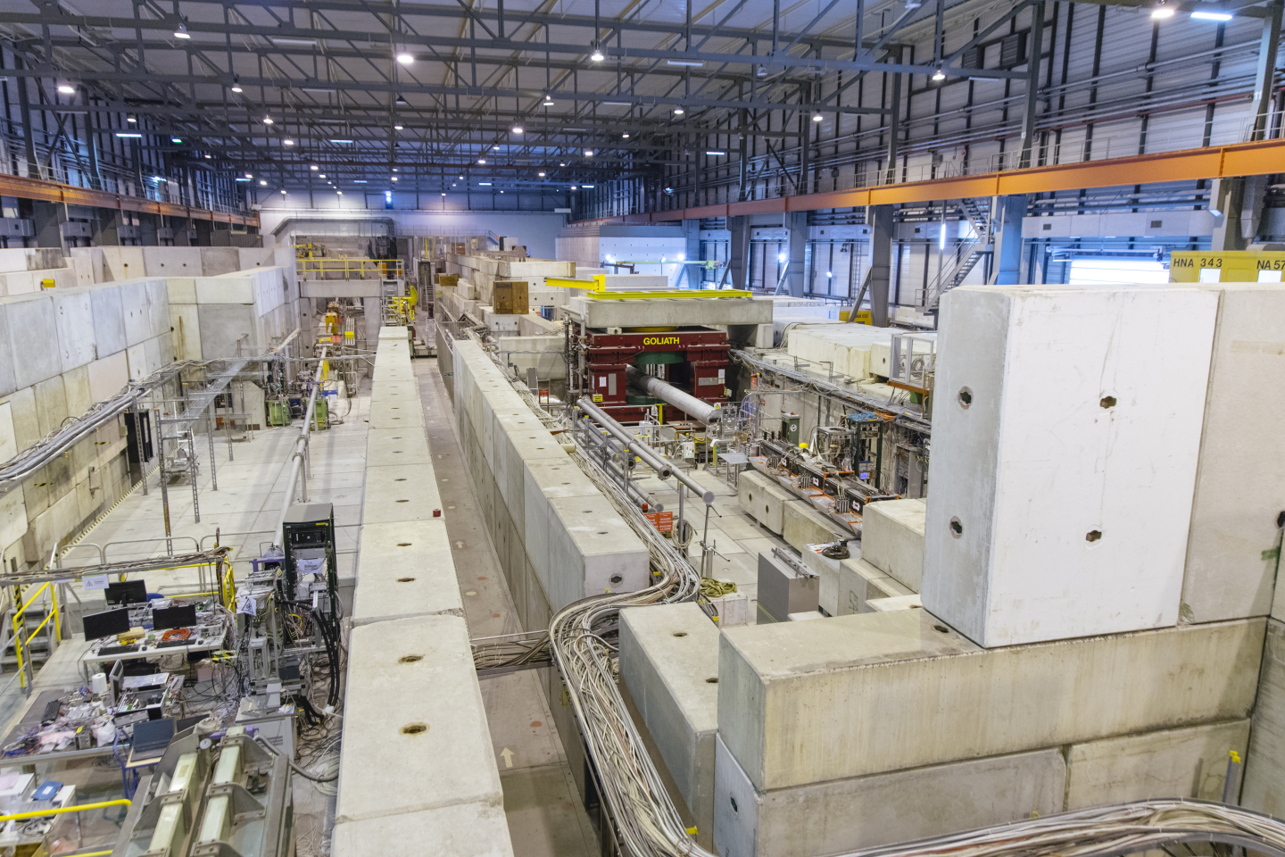
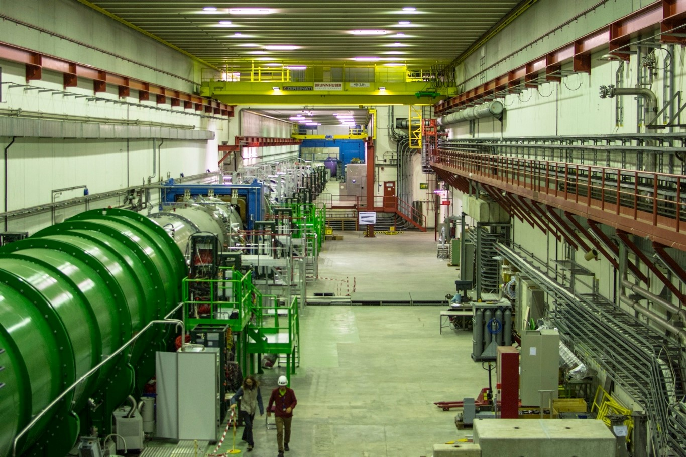
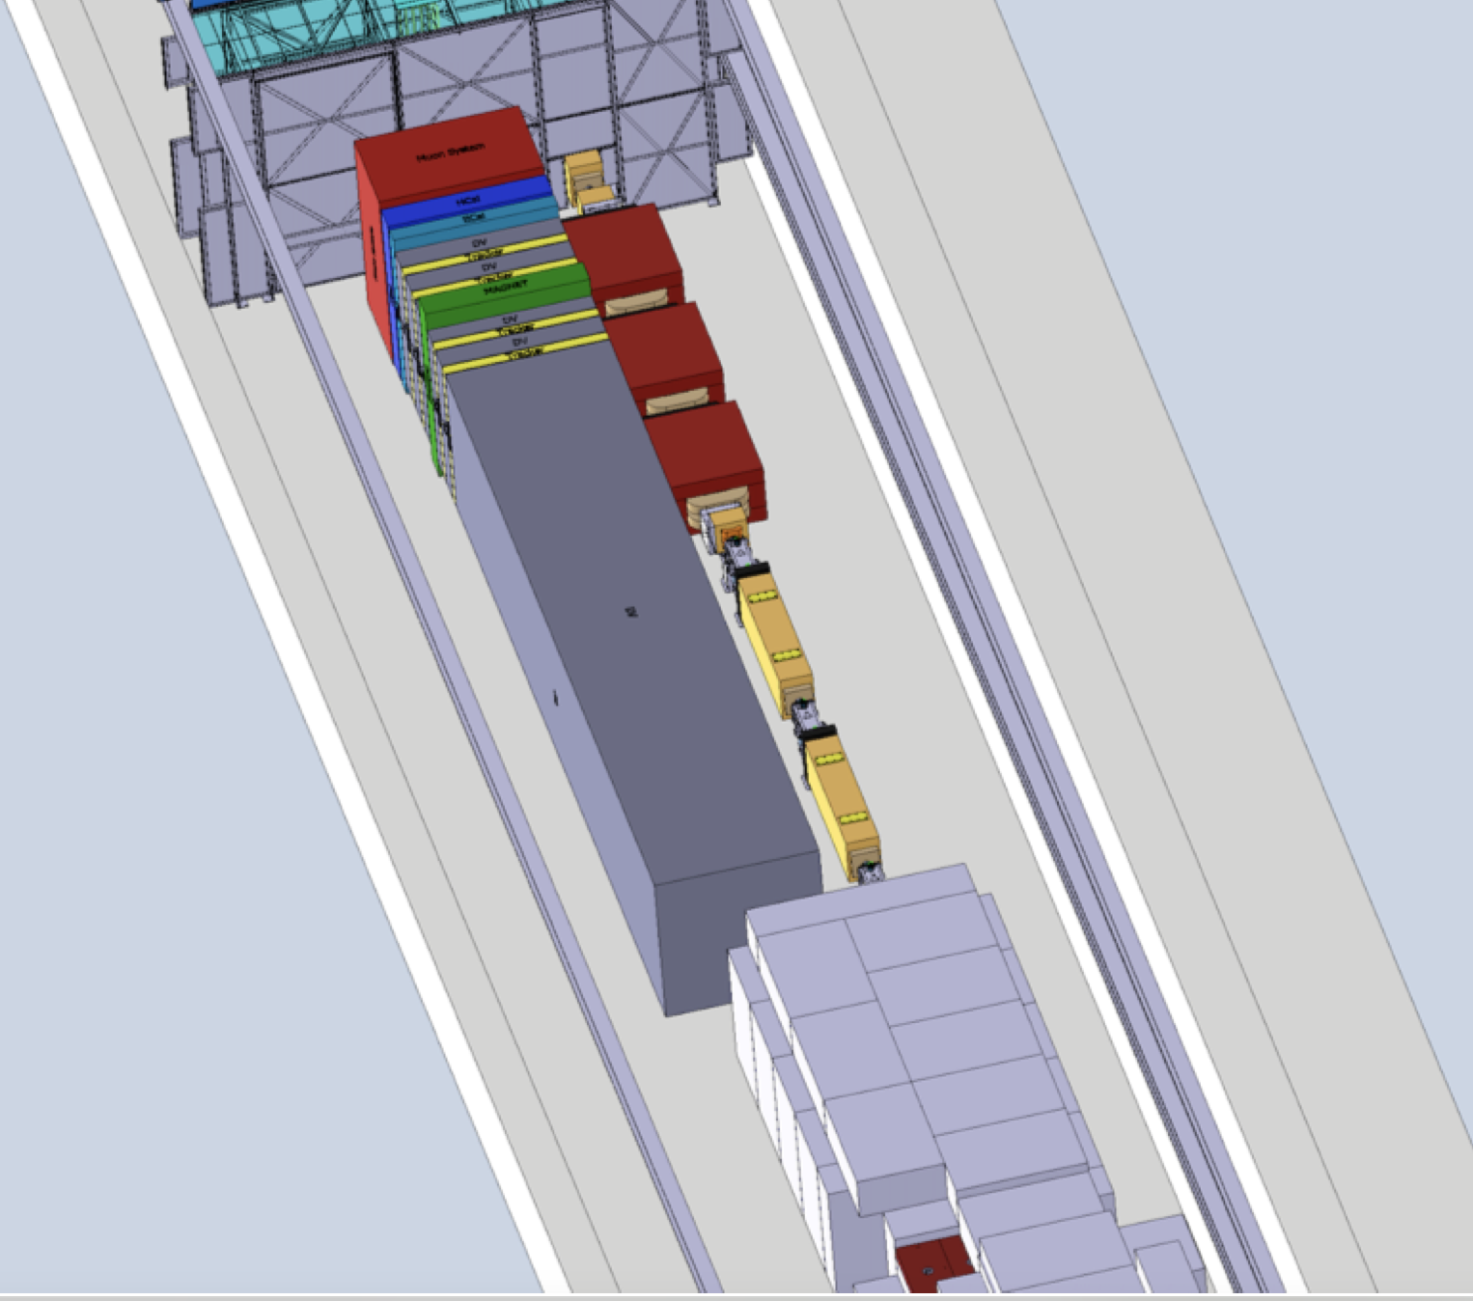
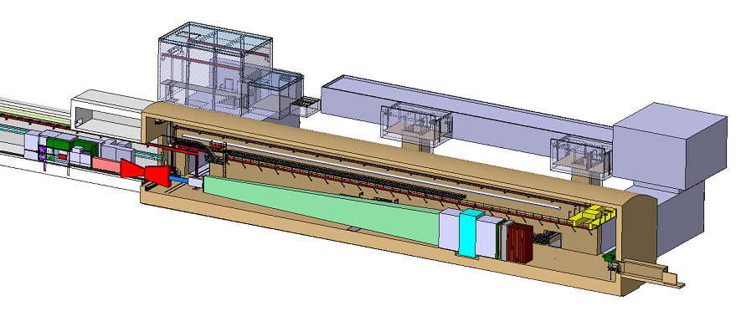
FIXED TARGET EXPERIMENTS
Old fixed target experiments (suitably re-interpreted) set constraints on light LLPs.
At CERN, ongoing experiments at the SPS (NA62, NA64) have set world-leading limits, and proposed experiments (SHiP, SHADOWS) have sensitivity far into new parameter space in many models.
SLAC E137 (1988)
Batell, Essig, Surujon (2014)
NA64
NA62
SHADOWS
SHiP@ECN3

Slide 26
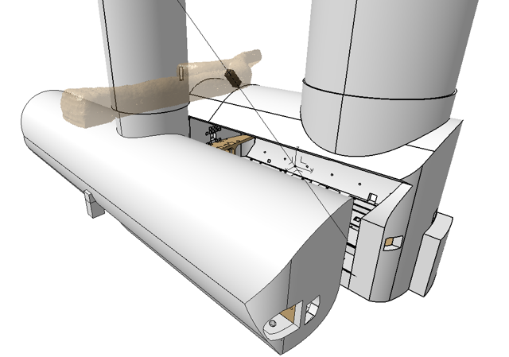

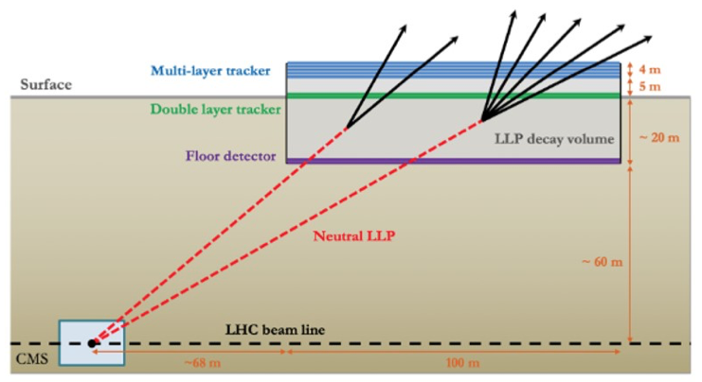
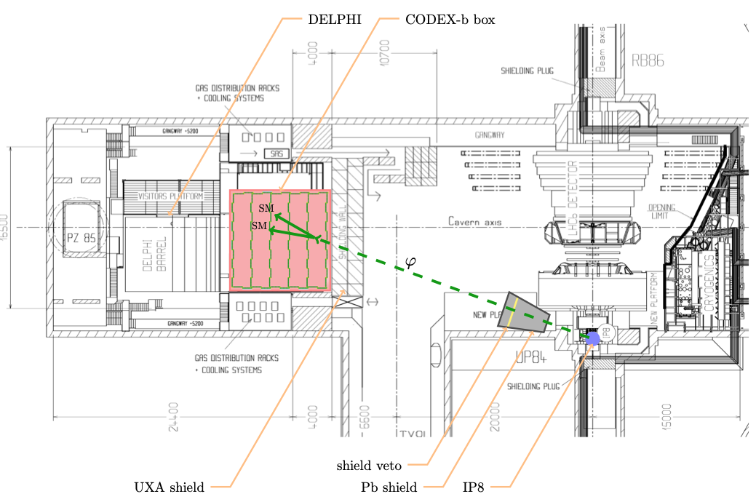
DEDICATED TRANSVERSE LHC EXPERIMENTS
The LHC provides unique opportunities at the energy frontier. Several ongoing and proposed detectors are dedicated to searching for LLPs and milli-charged particles at large angles to the beamline.
MoeDAL/MAPP, MilliQan, MATHUSLA, Codex-b, ANUBIS, …
MilliQan Collaboration (2104.07151)
MATHUSLA White Paper (2203.08126)
CODEX-b White Paper (2203.07316)

Slide 27
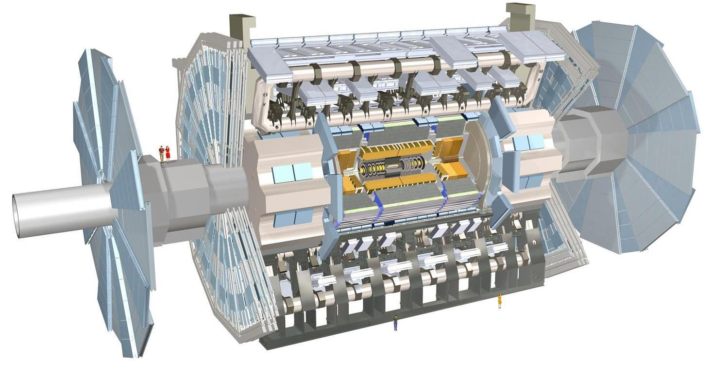
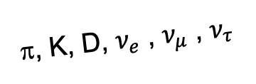
DEDICATED FORWARD LHC EXPERIMENTS
In the last few years, we’ve increasingly realized that the large LHC detectors are beautifully optimized to discover new heavy particles, but also beautifully optimized to miss new light particles.
Heavy particles are produced at low velocity and then decay roughly isotropically to other particles.
But high-energy light particles are dominantly produced in the forward direction and escape through the blind spots of existing detectors.
This is true for all known light particles: pions, kaons, D mesons, neutrinos.
It is also true in many models for many hypothetical new particles: dark photons, dark Higgs bosons, HNLs, ALPs, light gauge bosons, …
These blind spots are the Achilles heels of the large LHC detectors.
De Rujula, Ruckl (1984)
A’, a, mCPs, χ, …
π, K, D, $ν_{e}$ , $ν_{μ}$ , $ν_{τ}$

Slide 28
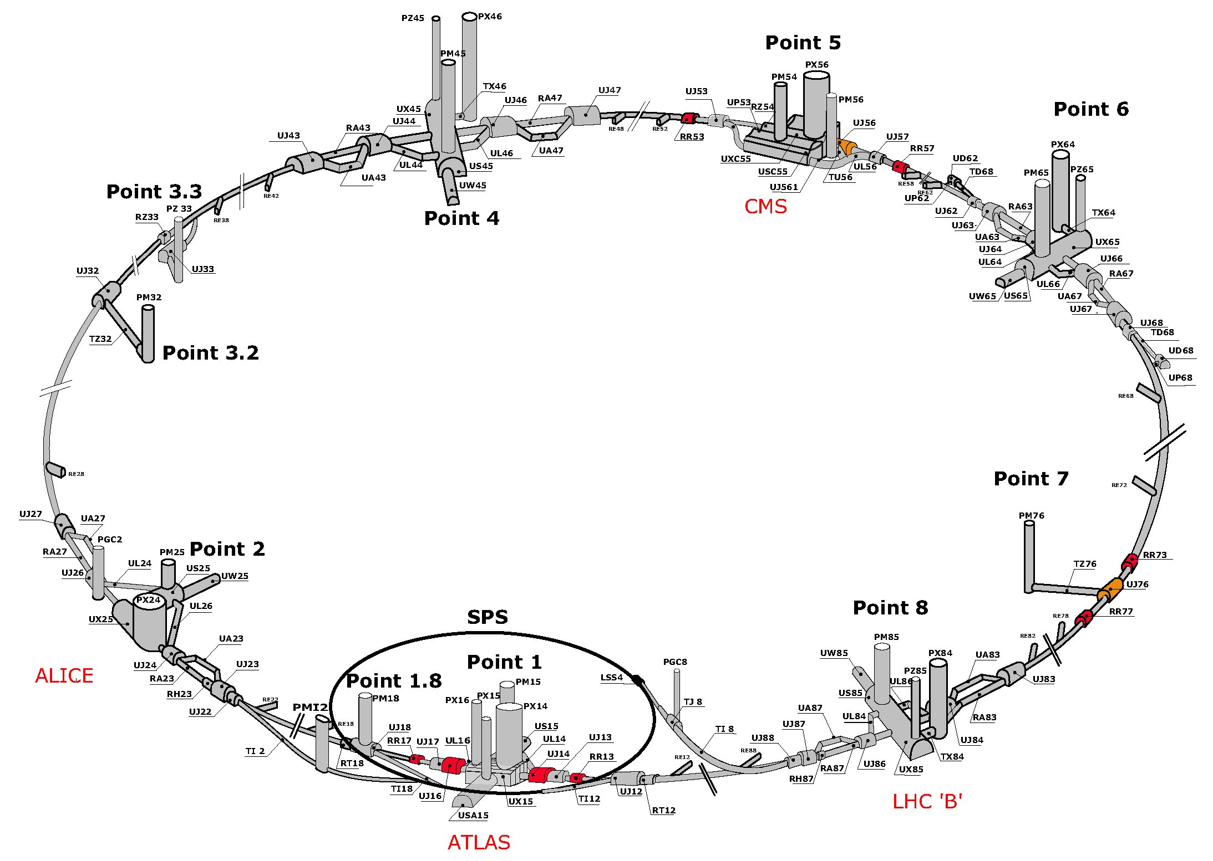
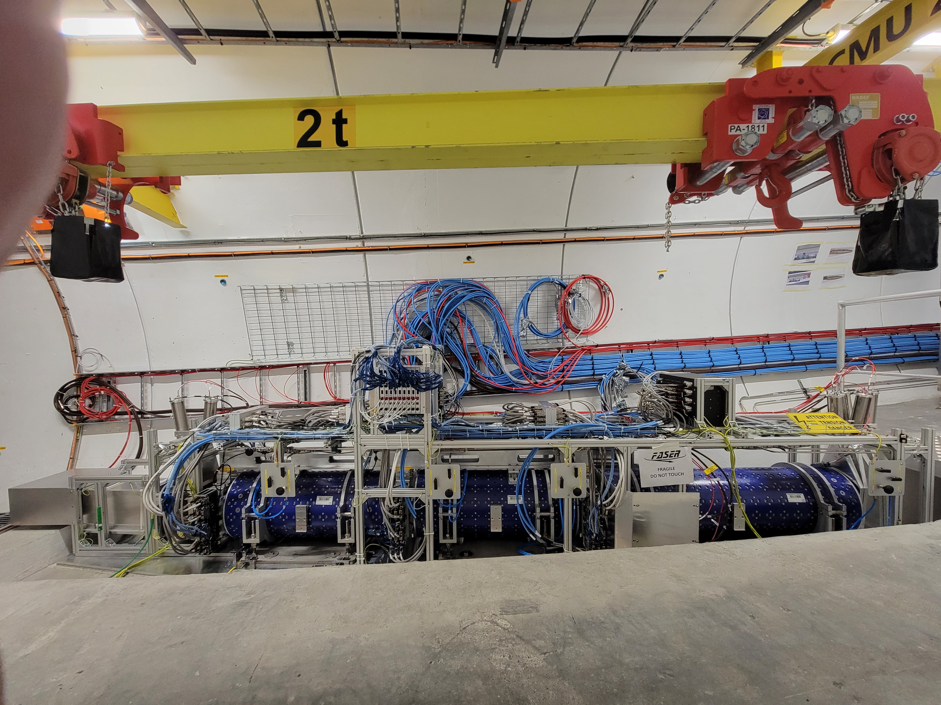
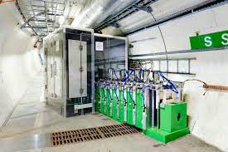
PRE-EXISTING TUNNELS FOR FORWARD EXPTS
Feng, Galon, Kling, Trojanowski (2017)
FASER, FASERν
!!!
SND@LHC

Slide 29
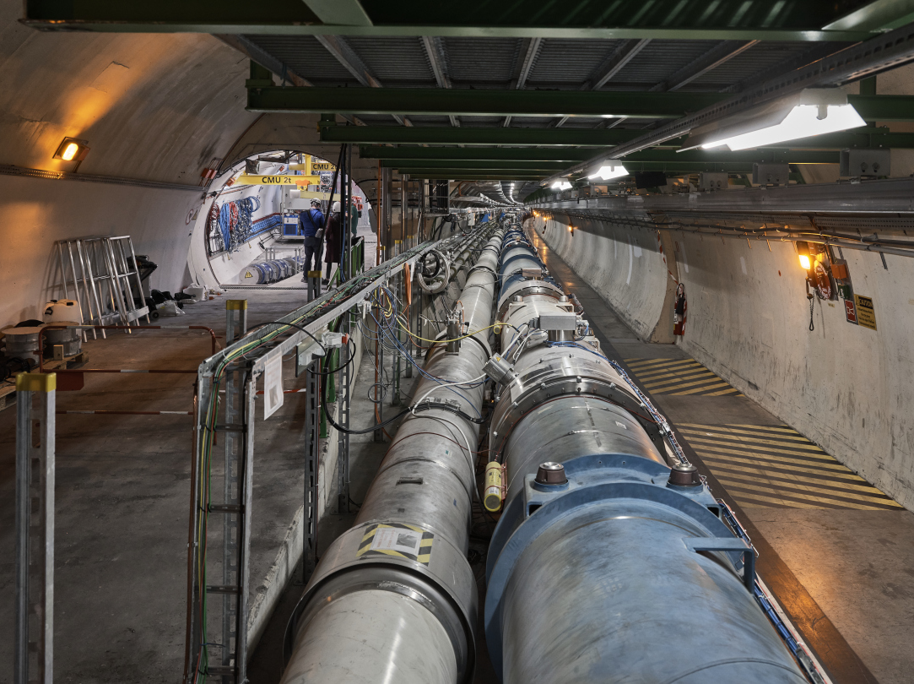
FASER AND THE LHC

Slide 30
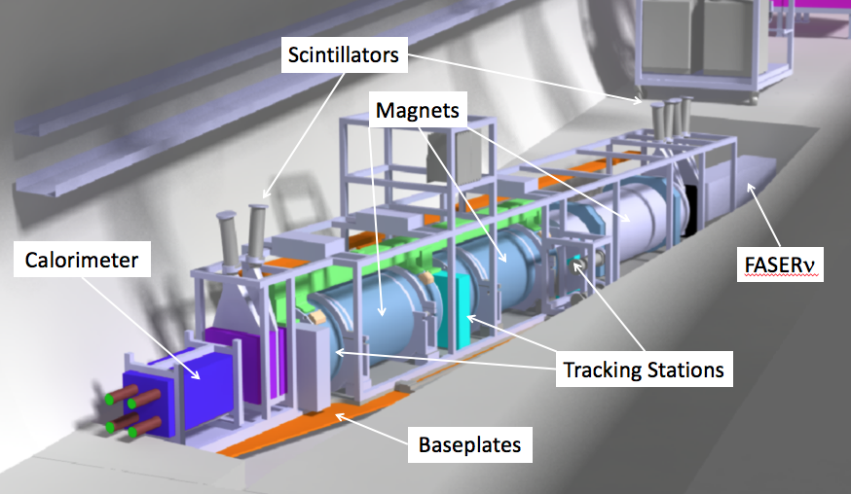
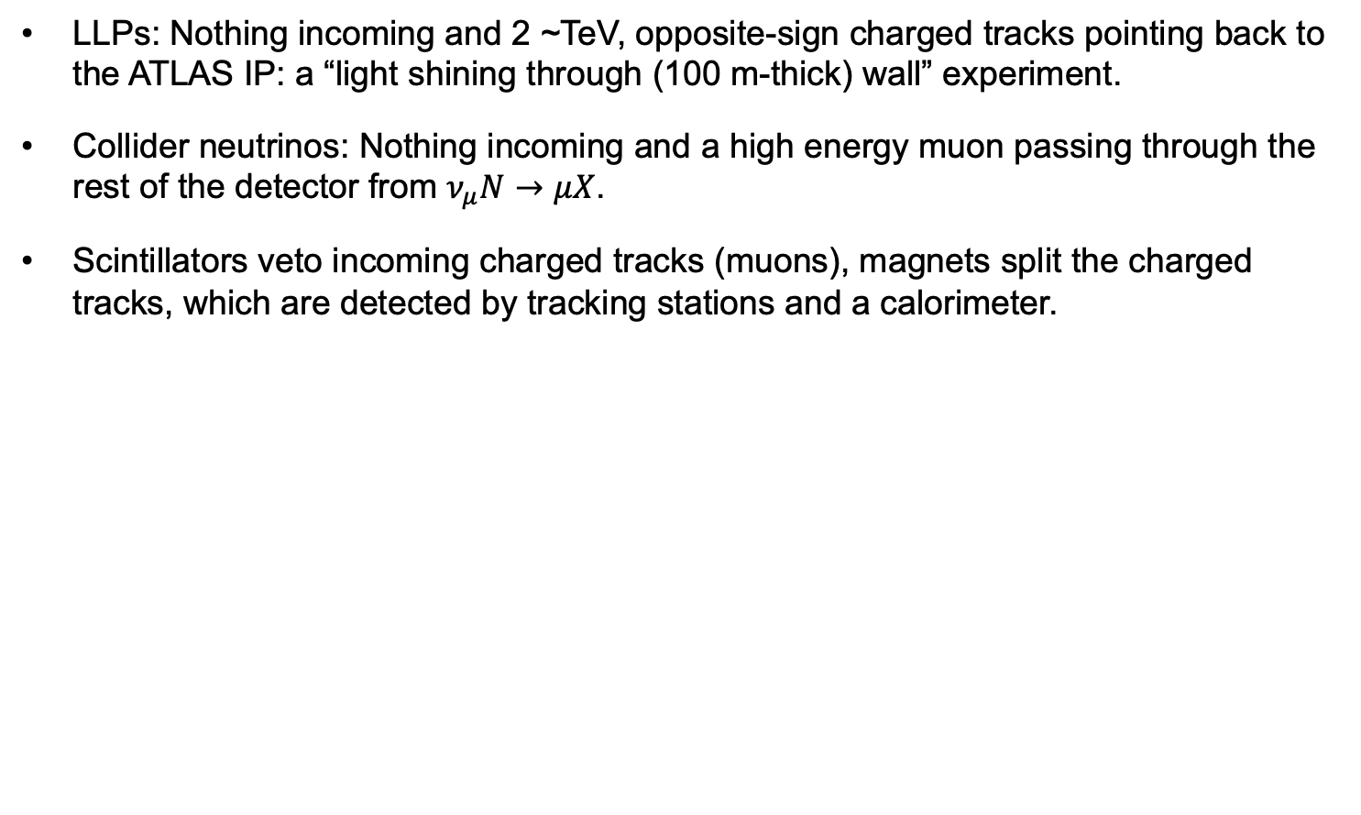
SIGALS AT FASER
LLPs: Nothing incoming and 2 ~TeV, opposite-sign charged tracks pointing back to the ATLAS IP: a “light shining through (100 m-thick) wall” experiment.
Collider neutrinos: Nothing incoming and a high energy muon passing through the rest of the detector from $ν_{μ}N→μX$.
Scintillators veto incoming charged tracks (muons), magnets split the charged tracks, which are detected by tracking stations and a calorimeter.
LLP
ν
e⁺
e⁻

Slide 31
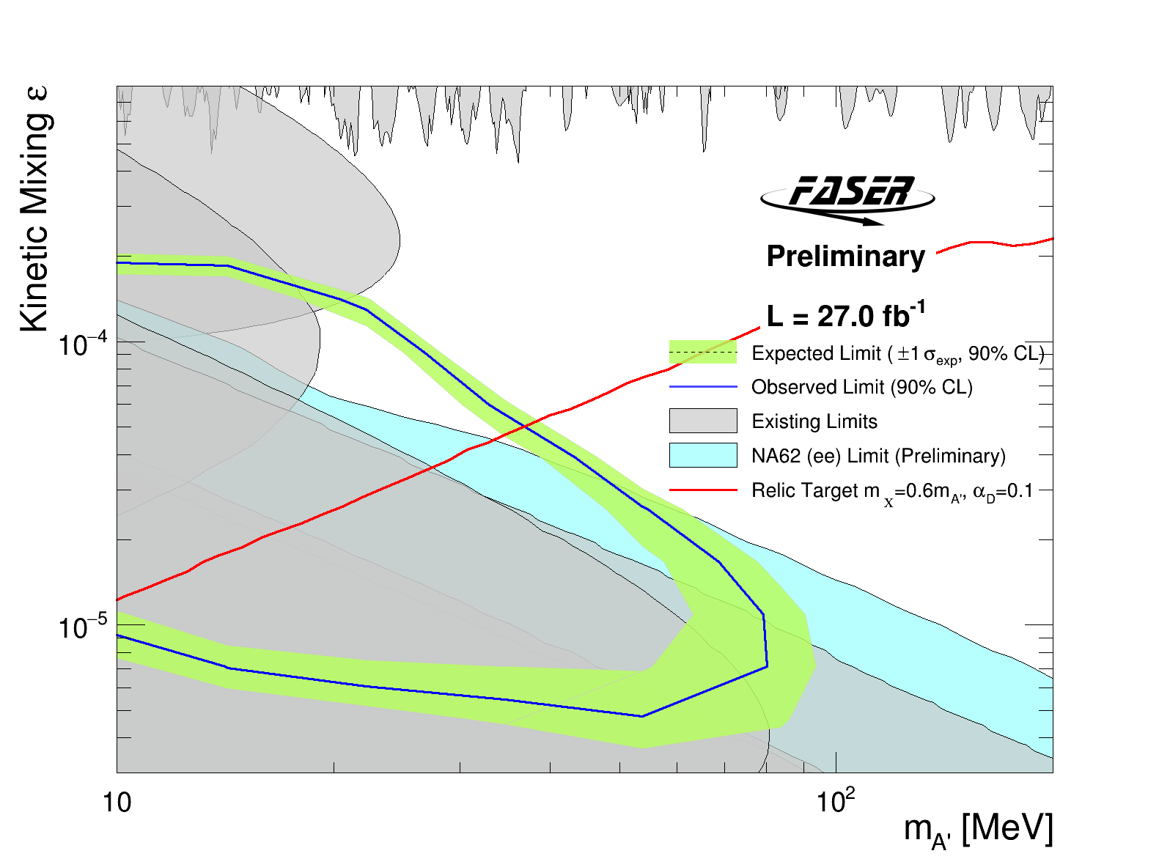
DARK PHOTON RESULTS
After unblinding, no events seen in signal region, FASER sets limits on previously unexplored parameter space.
Along with new results from NA62, these are the first new probes of the thermal relic region from low coupling since the 1990’s.
Background-free analysis bodes well for future sensitivity. Expect factor of ~10 more luminosity in Run 3 from 2022-25.
Existing bounds from DarkCast
CERN-FASER-CONF-2023-001

Slide 32
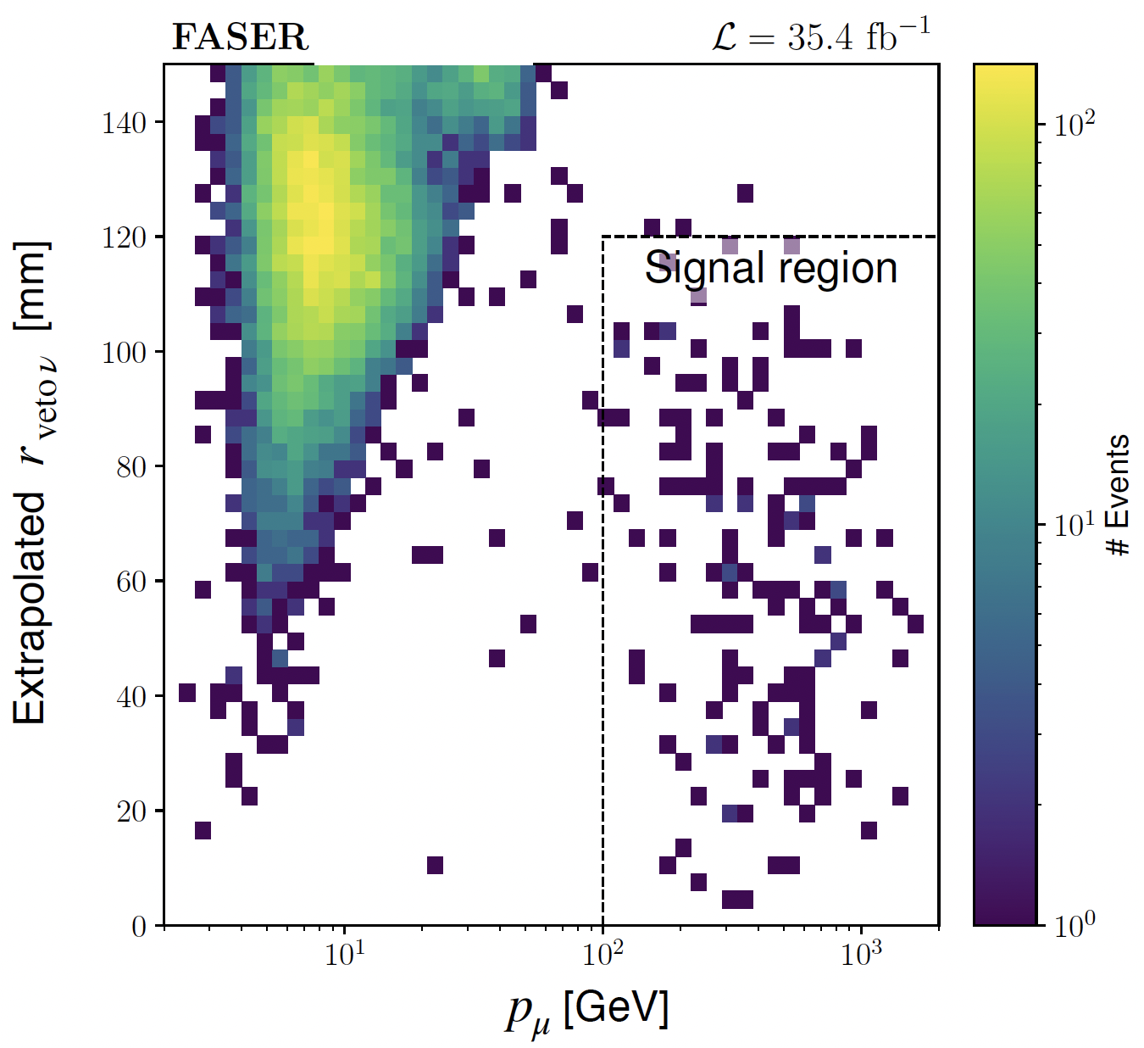
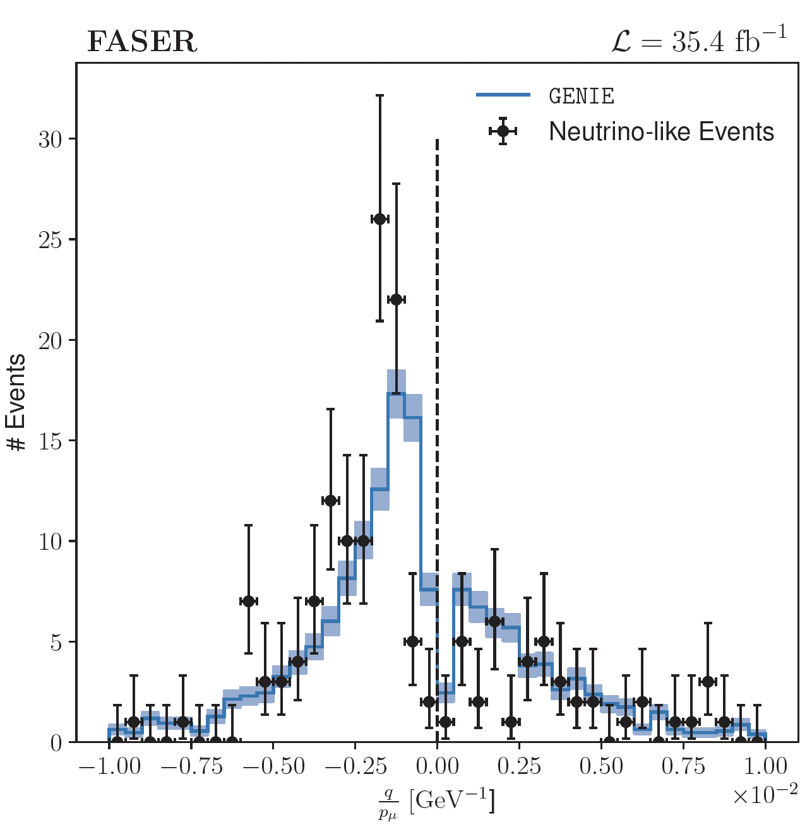
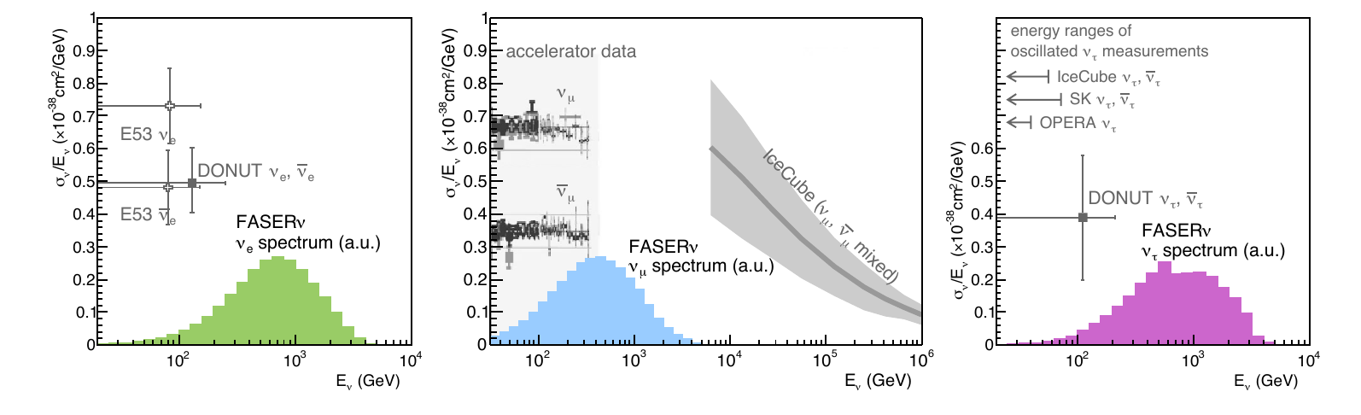
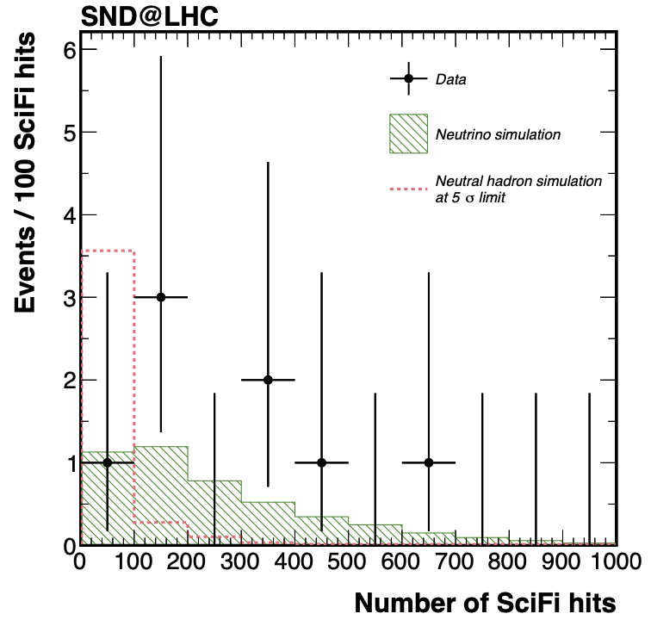

COLLIDER NEUTRINO RESULTS
With 2022 Run 3 data alone (~30 fb⁻¹), first direct observation of collider neutrinos: 153 events (FASER) + 8 events (SND@LHC), ~0 background.
Signal significance of ~16σ
Muon charge → both $ν$ and $\overline{ν}$
Almost certainly these include the highest energy $ν$ and $\overline{ν}$ from a human source
2303.14185, PRL
Kling, Nevay (2021)
2305.09383

Slide 33





NEUTRINOS FROM EMULSION IN FASERν
Much more to come: this analysis does not even use the emulsion data! Analysis underway, but already many neutrino candidates, including this event, which is likely the highest energy $ν_{e}$ interaction ever observed
Side View
Vertex with 11 tracks
615 µm inside tungsten
e-like track from vertex
Single track for 2X₀
Shower max @ 7.8Χ₀
θ_{e} = 11 mrad to beam
Back-to-back topology
175° between e & rest
Beam View

Slide 34












LOCATION, LOCATION, LOCATION
…
ALICE
ALEPH
FASER and SND@LHC
“Tabletop,” ~ 2 years*,
~$1M
161 neutrinos
*with essential help from ATLAS, LHCb!
CDF
ATLAS
DELPHI
D0
CMS
L3
LHCb
SLD
OPAL
All previous
collider detectors
Building-size, decades,
~$1B
0 neutrinos
Unambiguous discovery, opening up the new field of neutrino physics at colliders

Slide 35






FORWARD PHYSICS FACILITY
The rich BSM and SM physics cases motivate work on a dedicated Forward Physics Facility to house experiments that will greatly enhance the physics potential of the HL-LHC.
ATLAS
SPS
LHC
LOS
Core sample recently taken to study site geology, refine cost estimates
https://cds.cern.ch/record/2851822
CERN GIS

Slide 36

FPF EXPERIMENTS
At present there are 5 experiments being designed to explore the breadth of physics topics.
Millions of TeV-energy neutrinos will provide new probes of neutrino properties, QCD, and astroparticle physics.
O(10⁴) times greater sensitivity for new particle searches.

Slide 37



A CAUTIONARY TALE
Sometimes to look forward, it pays to first look back.
2021 was the 50th anniversary of the birth of hadron colliders.
In 1971, CERN’s Intersecting Storage Rings (ISR), with a circumference of ~1 km, collided protons with protons at center-of-mass energy 30 GeV.

Slide 38



ISR’S LEGACY
During ISR’s 50th anniversary, there were many fascinating articles and talks by eminent physicists looking back on the ISR’s legacy.
“Enormous impact on accelerator physics, but sadly little effect on particle physics.” – Steve Myers, talk at “The 50th Anniversary of Hadron Colliders at CERN,” October 2021.
“There was initially a broad belief that physics action would be in the forward directions at a hadron collider…. It is easy to say after the fact, still with regrets, that with an earlier availability of more complete… experiments at the ISR, CERN would not have been left as a spectator during the famous November revolution of 1974 with the J/ψ discoveries at Brookhaven and SLAC .” – Lyn Evans and Peter Jenni, “Discovery Machines,” CERN Courier (2021).
Bottom line: The collider was creating new forms of matter (charm), but the detectors focused on the forward region (along the beamline) and so missed them. Let’s not follow this precedent!

Slide 39
SUMMARY
LLPs are likely to play an essential role in the next breakthrough that takes us beyond the standard model.
LLPs are ubiquitous in BSM theories, especially those with cosmological significance.
LLPs can be detected through a huge variety of signatures.
Many of these signals are truly spectacular – a few events can be a discovery.
For existing experiments, we have not yet reached the full LLP discovery potential.
LLPs also present many opportunities for new experiments, some of which are already bearing fruit.

Slide 40
EXTRAS

Slide 41
FORWARD PHYSICS FACILITY
The physics program in the far-forward region has been developed in a series of meetings and papers.
FPF Meetings
FPF Kickoff Meeting, 9-10 Nov 2020
FPF2 Meeting, 27-28 May 2021
FPF3 Meeting, 25-26 Oct 2021
FPF4 Meeting, 31 Jan-1 Feb 2022
FPF5 Meeting, 15-16 Nov 2022
FPF6 Meeting, 8-9 June 2023
FPF Papers
FPF “Short” Paper: 75 pages, 80 authors, Phys. Rept. 968, 1 (2022), 2109.10905.
FPF White Paper: 429 pages, 392 authors+endorsers representing over 200 institutions, J. Phys. G (2023), 2203.05090.
Snowmass 2022: “Our highest immediate priority accelerator and project is the HL-LHC, … including the construction of auxiliary experiments that extend the reach of HL-LHC in kinematic regions uncovered by the detector upgrades.”

Slide 42

FORWARD PHYSICS FACILITY
The FPF is proposed to run at the HL-LHC with implications for
Neutrinos: neutrino blind → neutrino factory (10⁶ neutrinos at the highest human-made energies ever).
New particles: dark matter, dark sectors, milli-charged particles, new force particles, new Higgs-like particles, sterile neutrinos, quirks, …

Slide 43



FUTURE EXPERIMENTAL SEARCHES
For the future, dedicated detectors have significant discovery potential for a wide variety of dark sector particles: dark photons; B-L and related gauge bosons; dark Higgs bosons; HNLs with couplings to e, mu, tau; ALPs with photon, gluon, fermion couplings; light neutralinos, inflatons, relaxions, and many others.
_{FPF White Paper (2022)}
Dark Photon
Dark Fermion
Dark Scalar

Slide 44





THE FPF NEUTRINO PROGRAM
The FPF experiments will see ${10}^{5} ν_{e}$, ${10}^{6} ν_{μ}$, and ${10}^{4} ν_{τ}$ interactions at ~ TeV energies where there is currently no data.
Neutrinos are produced by forward hadron production: $π, K, D, …$. Energy spectra will inform
Astroparticle physics: muon puzzle, …
QCD: pdfs at x $\sim {10}^{−1}$, x $\sim {10}^{−7}$, intrinsic charm, small-x gluon saturation, …
Neutrino properties: $ν_{s}$ w/ $∆m^{2}\sim {10}^{3}$ ${eV}^{2}$
Fully differential neutrino DIS scattering cross sections will improve constraints on pdfs by up to a factor of ~2.
What else?
FPF WGs, PDF4LHC21,
stat uncertainty only

Slide 45



THE FPF QCD PROGRAM
The FPF will also support a rich program of QCD and hadron structure studies.
Forward neutrino production is a probe of forward hadron production, BFKL dynamics, intrinsic charm, and proton structure at ultra small x ~ 10⁻⁷ to 10⁻⁶.
Important implications for UHE cosmic ray experiments, future colliders, …
$$4m_{c}^{2 }\sim x_{1}x_{2}s$$
FPF White Paper (2022)

Slide 46



LIGHT PARTICLES AT THE LHC
300 fb⁻¹
Feng, Galon, Kling, Trojanowski (2017)
Most searches have focused on processes with σ ~ fb, pb.
But the total cross section is $σ_{tot}$~ 100 mb and is currently wasted in new physics searches.
What do these events look like? Consider pions.
Enormous event rates. Typical p_{T} ~ 250 MeV, but many with p ~ TeV within 1 mrad (η > 7.6) of the beamline.

Slide 47

COLLIDER NEUTRINOS
Neutrinos are the least understood of all known particles.
They have been discovered from many sources, each time with stunning implications for particle physics, astrophysics, and cosmology.
Formaggio, Zeller (2012)
But neutrinos produced at particle colliders have never been direct observed before, because they interact very weakly, and the highest energy ones, which are the most strongly interacting, pass through the blind spots of existing detectors.

Slide 48

NEUTRINO PHYSICS
In Run 3 (2022-25), FASERν’s goals are to
Discover the first collider neutrino at the highest human energies ever detected.
Record ~1000 ν_{e} , ~10,000 ν_{μ} , and ~10 ν_{τ} interactions at TeV energies, the first direct exploration of this energy range for all 3 flavors.
Distinguish muon neutrinos from anti-neutrinos by combining FASER and FASERν data, and so measure their cross sections independently.
Add significantly to the number of ν_{τ} detected and detect the first anti-ν_{τ} .
FASER Collaboration 1908.02310 (2019)
Only ~20 tau neutrino’s have been directly detected by experiment

